Slide 1
Brokerage in a Nutshell
Marcie Roggow, ABR/M, CCIM, CRB, CRS, DREI, GRI, SRS

Slide 2

Let’s see what you think!
At your table list what you think the Top 10 things are that you need to know to operate your real estate business today!

Slide 3
NAR Legal Scan Determined Risks
Major Topic | % Ranking Top 3 Next 2 Years | Average Rank | Std. Dev. | No. Resp.
Agency | 50.50% | 7.04 | 2.62 | 360
Ethics | 30.77% | 5.46 | 2.56 | 13
Technology | 29.17% | 5.21 | 2.80 | 24
Affinity Groups | 27.27% | 5.27 | 2.53 | 11
RESPA | 25.58% | 5.00 | 2.65 | 43
Property Condition Disclosure | 21.97% | 5.17 | 2.71 | 264
Third-party Liability | 18.18% | 3.91 | 2.94 | 11
Antitrust | 17.86% | 4.54 | 2.51 | 28
Employment | 13.33% | 4.22 | 2.37 | 45
Fair Housing | 11.11% | 4.22 | 2.45 | 27
ADA | 0.00% | 4.00 | 2.00 | 2
Relocation Companies | 0.00% | 3.67 | 1.70 | 3

Slide 4

I. Agent Sued for Breach of Fiduciary Duty to the Client
Now, keeping in mind that tweets could be entered as evidence in court, consider this tweet (I've removed the name from this one):
Stayed tuned there’s more!

Slide 5

Law of Advocacy
Law of agency governs relationship between clients and brokers.
A broker who “represents” a party is that party’s agent

Slide 6
SOP 1-9 Confidentiality Please!
The obligation of Realtors® to preserve confidential information (as defined by state law) provided by their clients in the course of any agency relationship or non-agency relationship recognized by law continues after termination of agency relationships or any non-agency relationships recognized by law. Realtors® shall not knowingly, during or following the termination of professional relationships with their clients:
Notes:
The Code of ethics is quite clear on the issue of confidentiality….and having said that….so is the license law of your state. The problem of course is that is probably the most violated of all of the fiduciary/statutory duties! Agents talk!...and now they tweet, and they facebook, and they text and heavens knows what else. What they probably don’t know is that everything they say electronically can be caused to be admissable in a court of law. Recently for an expert witness case I was doing the other side wanted me to relinquish all of the emails that I had between the defendant and myself. Fortunately…there weren’t any…since I don’t have contact with the client/defendant. But the agent who is in constant contact with the clients has emails and other electronic communications that indeed are searchable and can –due to the Dec 2006 amendments to the Federal Rules of Civil Procedure act…now allows discovery of electronically sotred information (ESI). Mindul of new and emerging technologies, the court intends ESI to cover all current types of computer based information plus future technology developments as well…..it of course now covers, email messges, attachments, IM cht, text messages, blog posts, history of we surfing, backup tapes, voice mail and all of forms of created , acquired, retained and archived data….which is subject to discovery in civil lawsuits. That would include information stored in the brokerage computer as well. So imagine an agent on a social media site….discussing the events of the day…like this one!

Slide 7
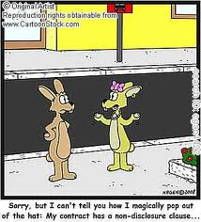
Full Disclosure
Licensee must convey all known information concerning offers and to keep the principal informed of significant information
Examples:
Affiliated Business Relationships
disclose if the agent owns an interest in the buyer
Written disclosure if licensee is a principal in the transaction (for entities

Slide 8
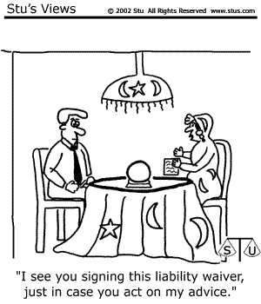
Uniform Contracts and Forms
Belong at the Brokerage
Web-based OR
Paper Files
What is needed for an audit needs to be there!
Digital Signatures
All Transactions!

Slide 9
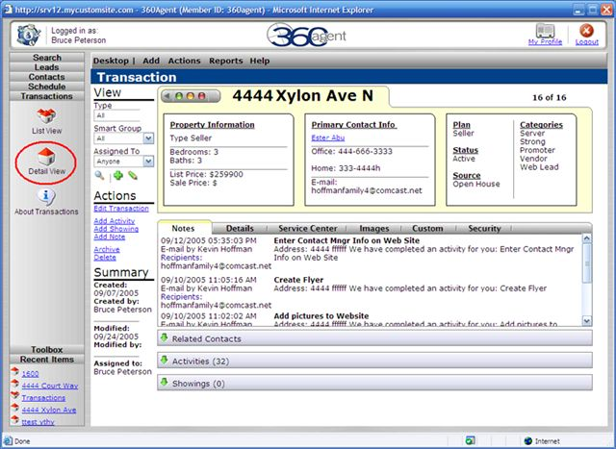
Transaction Management: ESI governed by FRCP
Dec 2006 new amendment to Federal Rules of Civil Procedure regarding
Electronically Stored Info
All ESI is subject to discovery in civil lawsuits. This means you are liable for discovery of all ESI of your Employees/Agents. What policy do you have in place?
Notes:
Not new news…but maybe new to you! While the old fashion file with letters, notes, memos etc were great…today’s file is on someone’s computer, or hard drive. Most companies are not using
Title companies are
why not…..
How are you guarantee the saving of the info…

Slide 10
ESI Creates the DNA evidence
Anything that is a business record MUST be kept!
Blogs and discussion threads on social sites regarding real estate
Emails
All forms
All communications between brokerages including clients/customers
Text messages, IM, and all attachments
Retention will be according to your state law (statute limitation)
Purging records prior to that time period shall be a direct violation of license law and FRCP.

Slide 11

“Would I retain this information if it were in writing?”
Cell phones, text messages, blackberries, whether provided by company or not are admissible in court!
What photos are you taking?
What are you uploading to social sites?
Do you have a signature block on your phone for text and email
Email confidentiality….very important.
Are you forwarding this whole thing?
Should this message/text/photo be saved

Slide 12
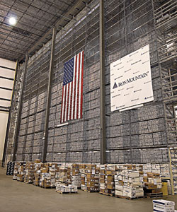
Retention Considerations
Consider the following related to a retention policy:
secure executed copies
use a chronological filing system
keep separate physical disk records
be able to convert digital record for delivery
remove transactional records from collective records
develop a written policy concerning access to records
FOR 3 YEARS and maybe longer…

Slide 13

III.Let’s Talk Commissions!

Slide 14

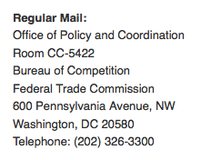
Who Gets the Money…How Much?

Slide 15
VII. Advertising Compliance!
Discussion concerns only RELA and Code of Ethics
Brokers are to ensure that each salesperson complies with advertising rules
broker should be able to demonstrate reasonable measures in place
Broker may wish to consider:
how salespersons’ advertisements are reviewed and by whom
periodic education of salespersons
how to document corrections to Ads

Slide 16
What’s An Advertisement?
Advertising.
For the purposes of this section, an "advertisement" is a written or oral statement or communication by or on behalf of a licensee which induces or attempts to induce a member of the public to use the services of the licensee or service provider. The term "advertisement" includes, but is not limited to, all publications, radio or television broadcasts, all electronic media including email, text messages, social networking websites, and the Internet, business stationery, business cards, signs and billboards. The provisions of this section apply to all advertisements by or on behalf of a licensee unless the context of a particular provision indicates that it is intended to apply to a specific form of advertisement.

Slide 17
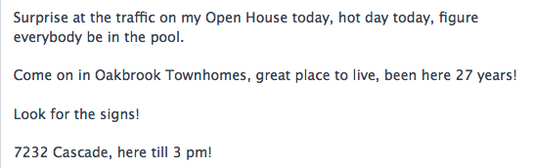
Advertisement or Water Cooler

Slide 18

Agent found guilty of failure to disclose company name in all advertisement!

Slide 19

Another great idea!
Larry Luetke Here we go.... 9 open houses this weekend. Come check out Harrisburg today. 5 great properties open in Harrisburg from 11:30 to 5 pm. Stop out. Any questions give me a call or text at 310-8886.
October 2 at 9:23am · Comment · Like

Slide 20
Brokerage company found guilty of violating Article 12 of COE!
SOP: 12-12
REALTORS® Shall not:
Use URLs or domain names that present less than a true picture, or…
Register URLS or domain names which, IF USED, would present less than a true picture (adopted 1/08)

Slide 21
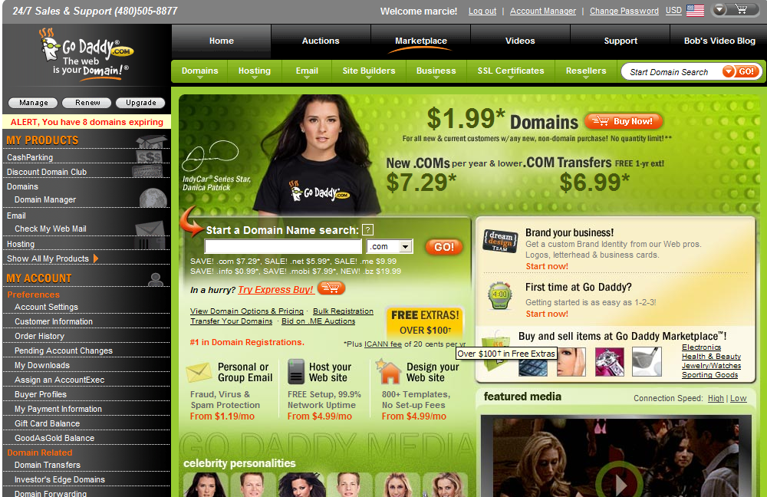
Notes:
But today you can go out to any provider of domain name registration and have a hey day. Long ago someone beat us to CRS.com….and we had to ‘buy’ it back for a pretty penny. Today that person…because they are a realtor member, would be in violation of article 12. Because even if they just BOUGHT it and never used it or directed traffic to their website by directing the domain name to their site…the shear ownership creates the problem. Let me give you some examples from our discussions at the committee this last fall.

Slide 22
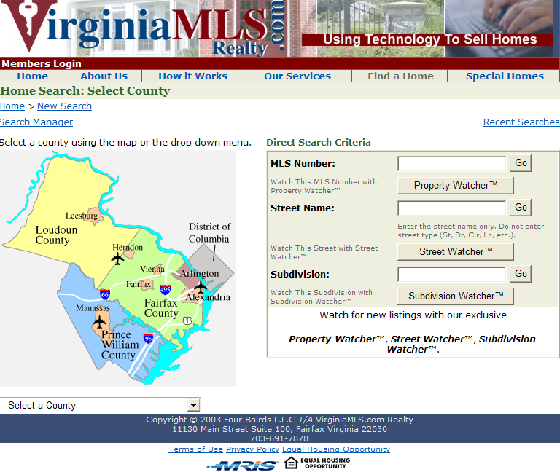
Notes:
What you see here appears to be an MLS where you can search by counties and MLS numbers….but this is an individual real estate agent.

Slide 23


Pictures on Websites and Blog Posts

Slide 24

VIII. Policies for the Brokerage to Consider…

Slide 25
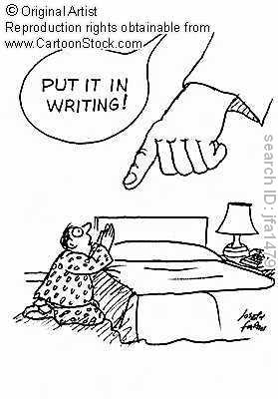
Written Policies Required
Brokers must maintain written policies and procedures addressing
the relationship between the broker and agents
competency of agents
compensation issues
maintenance of trust accounts
maintenance of business records

Slide 26

Is the Team Concept for your office?

Slide 27
A Team Friendly Office Provides
Productive Work Environment
Support Services
Resources/Efficient Systems
Positive Atmosphere
Training Programs….
What’s the liability?

Slide 28
Advertising Teams
A licensee broker or salesperson may not place an advertisement that in any way implies that the salesperson is the person responsible for the operation of a real estate brokerage business
An advertisement must contain the name of the broker (either the individual name of the entity’s name)
If broker uses an assumed name, use of assumed name in Ad complies
If assumed name or the corporate name contains the name of a salesperson, the advertisement must also include the name of the broker

Slide 29
Advertising Teams (cont.)
Licensee Anderson is Team leader
Is it permissible to advertise as “Edra Anderson and Associates?”
No
Consumers may be confused as to who is responsible for the brokerage operations
Edra Anderson Group and The Edra Anderson Team are OK if the broker’s name or assumed name is also in the AD
Edra Anderson Group or Edra Anderson Team are corporate names and corporation holds broker license, then the designated officer’s name should be included In developing a policy regarding teams, a licensee

Slide 30

Unlicensed Assistants
Unlicensed may not conduct any of the activities for which licensure is required
Constitutes criminal activity to engage in licensed activity
Licensee who employs the unlicensed might be criminally charged as well
TREC may take disciplinary action against a licensee who pays or associates with an unlicensed person who engages in

Slide 31
Direct Activities by Unlicensed Assistants
Direct activities include:
negotiating a listing
“showing property” (note merely unlocking door)
Negotiating a contract or lease
Other activities in definition of “broker”

Slide 32

Internet: Friend or Foe?

Slide 33

Do you have policies in place

Slide 34

Q & A Platforms
Trulia Voices
Zillow Advice
Yahoo! Answers

Slide 35
…AND ANSWER QUESTIONS ON TRULIA VOICES
“As for the MLS or discount brokers, sometime it does appear on the MLS but 1) that broker only wants to list your house to get buyer leads so he can sell them other homes that aren’t overpriced. 2) Me being a realtor, I know which brokers are discount brokers and I never show there homes. If I bring an offer and then the owner gets a little lower offer he will take that one because he is FSBO and doesn’t have to pay commission so I wasted my time showing that home and not get paid. 3) If I show it and the buyers go directly to the owner then im out of commission so I steer them away from those properties. Do it right the first time and hire a qualified realtor rather then waste your money GOOD LUCK!!!!”

Slide 36
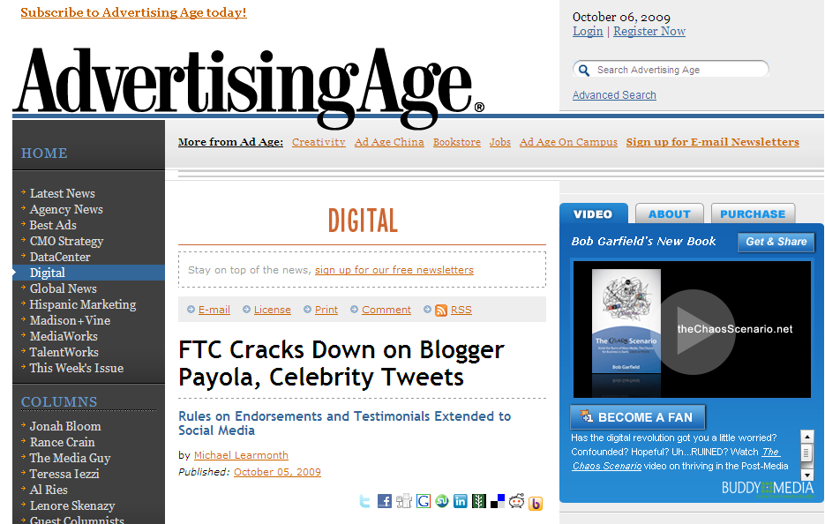
Personal Web Sites & Blogs

Slide 37
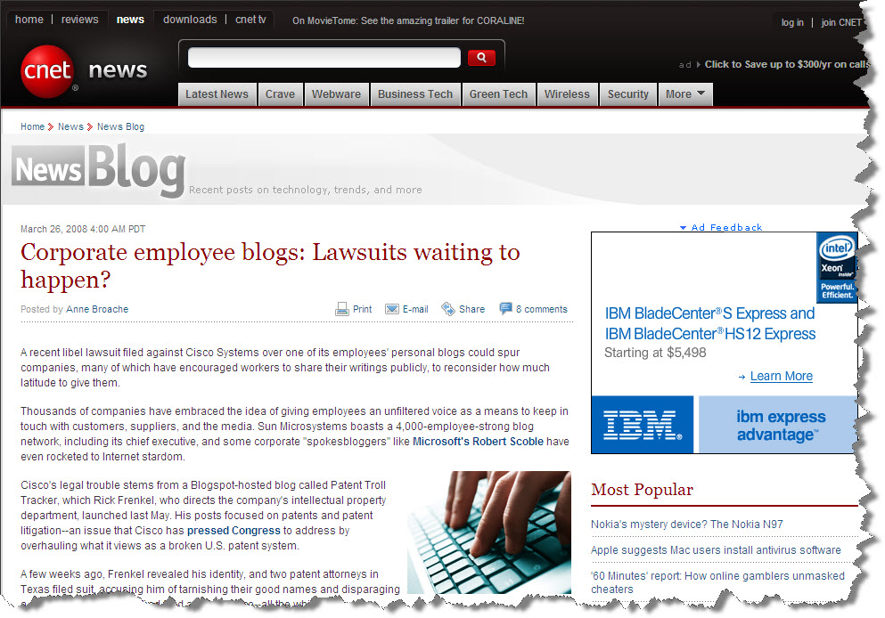
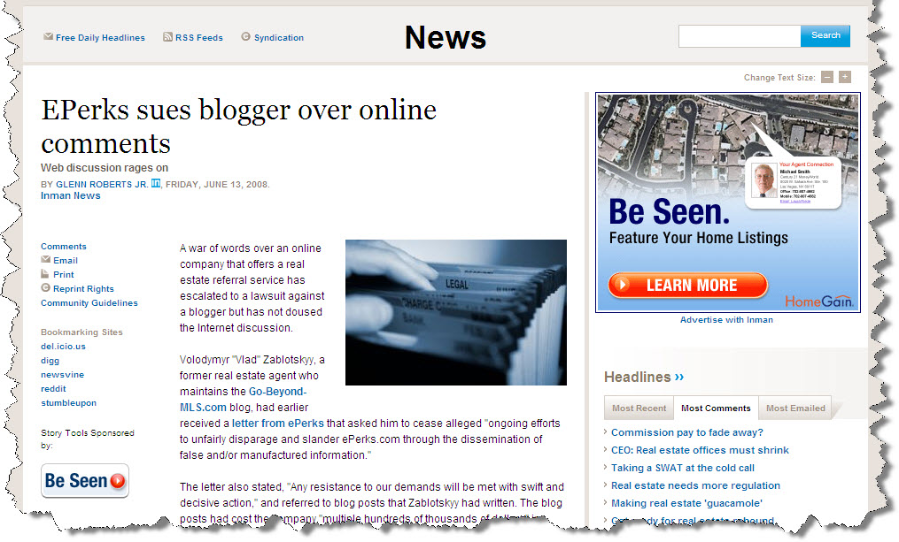
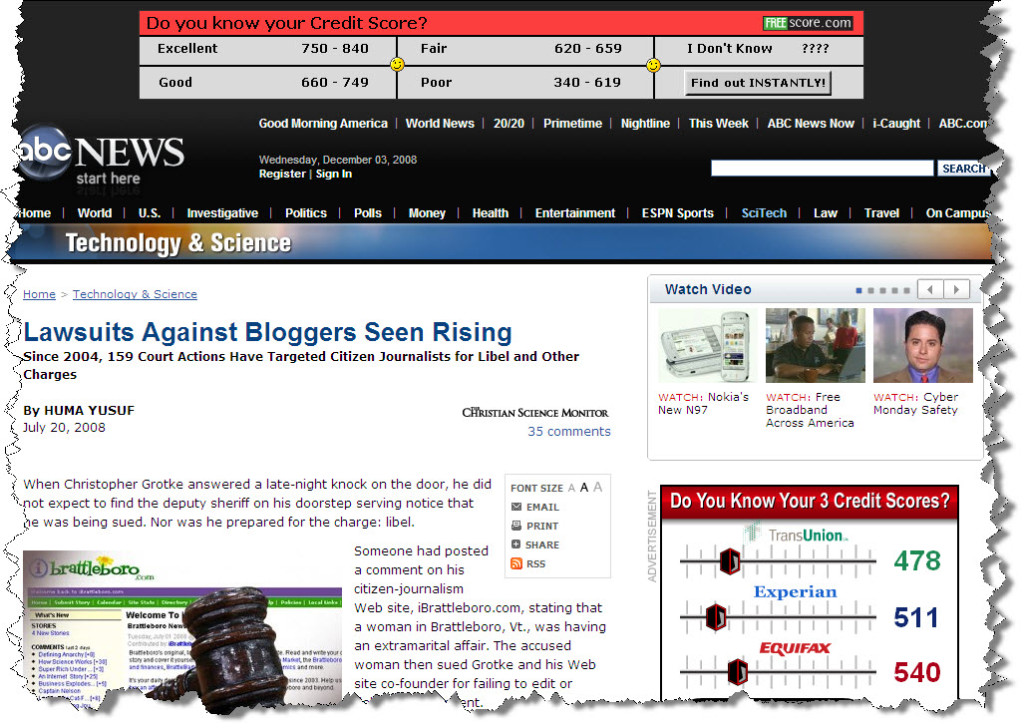
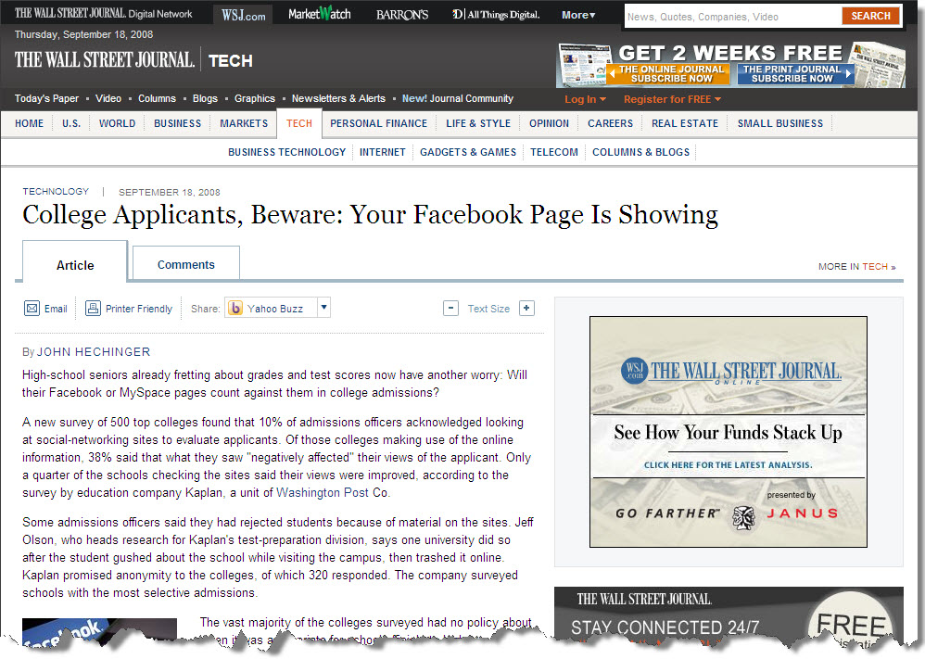
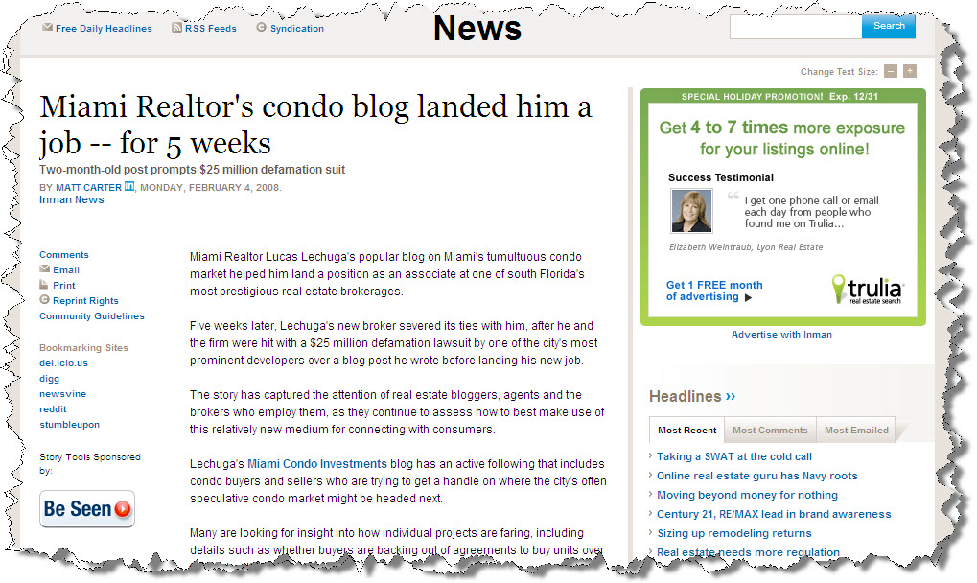
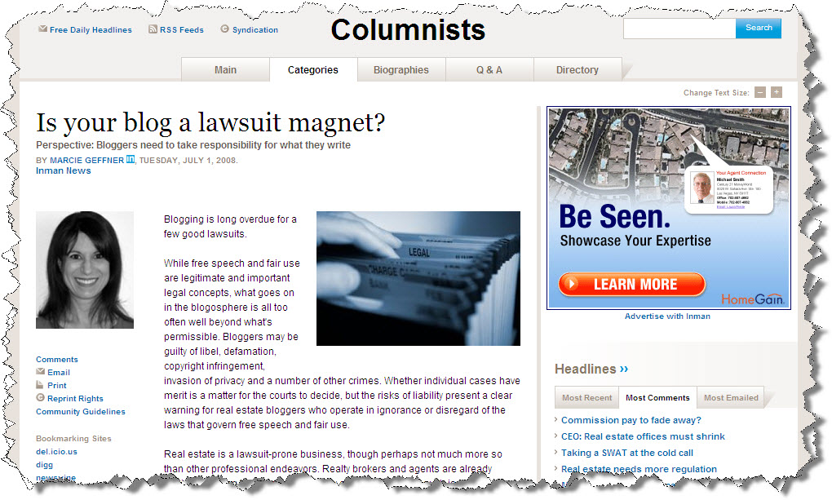
Headlines you Don’t want to see!
Notes:
Blogging became a fast hit with realtors. It was a way to promote a city, a neighborhood, yourself…how and when to buy…when to sell…market conditions, etc! Well the probably with blogging is that it is normally ‘your opinion’…so when that opinion turns out to be wrong, then what you have is the potential for a lawsuit and shown by thiese articles.

Slide 38
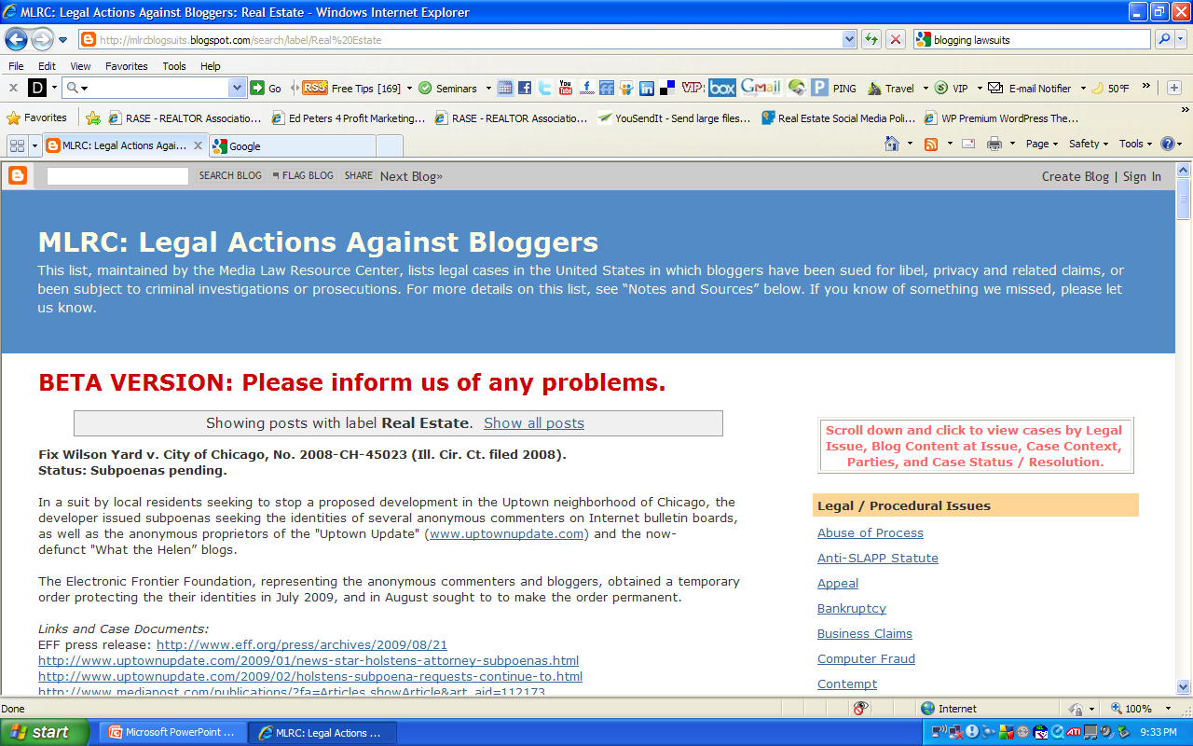

Slide 39
Online Community Policy (e-mail, social networks, agent websites)
Care with social media and on-line communications are needed
Need to avoid defamation and copyright infringement
Make sure written statements
If doubt exists, qualify or describe as opinion
Always quote source, even blogs from others
Publish contact information for those who may object to contact publisher

Slide 40
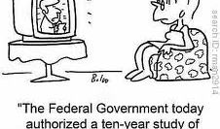
VIII. Federal Rules and Regulations

Slide 41

Do-Not-Call
Licensees who make “cold calls” must comply with National Do-Not-Call registry
Before making cold call, a licensee must verify if the number is on the do-not-call registry
Cannot make “cold calls” to numbers in the registry unless EBR exists
Licensee must update registry at least every 31 days
Licensee must maintain an internal do not call list

Slide 42
Do Not Call (cont.)
Cannot call anyone on the internal do not call list (no exceptions)
Cannot call anyone on national do not call registry unless EBR exists
EBR exists:
They were a party to a transaction with broker in last 18 months
They made an inquiry with broker in the last 3 months
Can always call if consumer grants prior written permission
Requests to be placed in the internal list must be honored for 5 years
Internal list applies to all agents in the firm
Should maintain a central internal do not call list

Slide 43
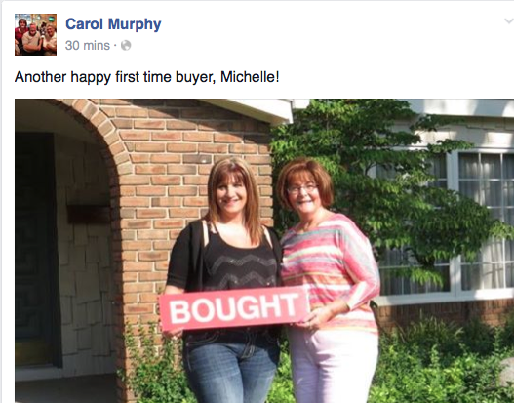

Slide 44
REALTORS®
Do Not Discriminate………….period!

Slide 45

Common Section 8 RESPA Don’ts
A title company hosts a monthly dinner and reception for real estate agents.
A mortgage broker pays for a lock-box for the broker.
A mortgage lender provides lunch at an open house. (Note a lender could purchase advertising rights from the broker at the open house).
An insurance company hosts a “happy hour” and dinner outing for real estate agents.
A home inspector pays for a real estate agent to go to dinner but does not attend the dinner.

Slide 46
Common Section 8 RESPA Don’ts (cont.)
A title company makes a lump-sum payment or pays for other costs toward a function hosted by the real estate agent but does not provide advertising materials or make a presentation at the function.
A mortgage broker buys tickets to a sporting event for a real estate agent or pays for the real estate agent to play a round of golf.
A title company sponsors a “getaway” in a tropical location during which only an hour or two is dedicated to education and the remainder of the event is directed toward recreation.
A mortgage lender only pays a real estate agent for taking the loan application and collecting credit documents if the activity results in a loan.

Slide 47

Permissible under RESPA
Lender sponsors an educational lunch for agents where employees of the lender are invited to speak.
If lender subsidizes the costs of continuing education credits, this activity may be seen as defraying costs the agent would otherwise incur, and may be characterized as an unallowable referral fee
A title company pays for advertising at an event that various individuals, including real estate agents, will attend; it posts a sign identifying the title company’s contribution to the event in a prominent location for all attending to see and distributes brochures regarding the title company’s services.
An insurance company provides notepads, pens, or other office materials reflecting the insurance company’s name.

Slide 48
Permissible under RESPA
A mortgage brokerage sponsors the hole-in-one contest at a golf tournament and prominently displays a sign reflecting the mortgage brokerage’s name and involvement in the tournament.
A real estate agent and mortgage broker jointly advertise their services in a real estate magazine, provided that each individual pays a share of the costs in proportion with his or her prominence in the advertisement.
A lender pays a licensee fair market value to rent a desk, copy machine, and phone line in the licensee’s office for a loan officer to prequalify applicants.

Slide 49
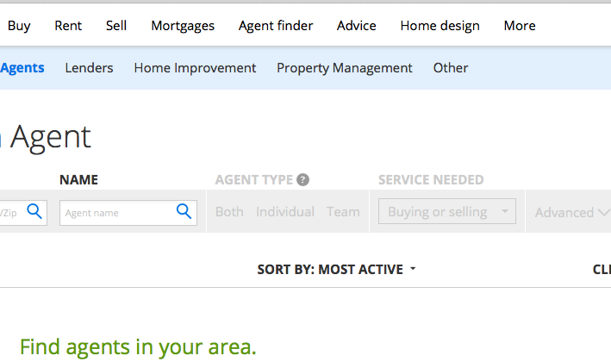
IX. Public Relationships/Testimonials

Slide 50
Reputation Management
Your agents are a reflection of you!

Slide 51
Informing and Responding to Clients
Have a duty to disclose important information to the principal
all known information that would affect the principal’s decision on any offer
all significant information relating to the transaction
A principal may direct agent in writing NOT to submit subsequent offers after entering into a contract
Licensees must be honest and fair to all including non-clients and not provide inaccurate information
Supervising broker should be available during all normal business hours
Supervising broker should monitor transactions

Slide 52
Take a Tip from Marriott
89% of guests with no problems ….we’ll be back
69% of guests with problems not resolved…we’ll be back
94% of guests with problems that were resolved…we’ll be back

Slide 53
New Provisions to the Code
SOP 15-2 amended.
The obligation to refrain from making false or misleading statements about competitors, competitors businesses and competitors’ business practices includes the duty to not knowingly or recklessly publish, repeat, retransmit or republish false or misleading statements made by others. This duty applies whether the false or misleading statements are repeated in person, in writing, by technological means (i.e. the Internet) or by any other means.
Notes:
This past May the NAR board of directors approved several motions from the Professional standards committee….here is one that should be interesting to monitor….the underlined words are the additions to the existing SOP> READ IT! Then look at the follow up to this SOP

Slide 54
And a NEW SOP for Article 15 ----
“The obligation to refrain from making false or misleading statements about competitors, competitors’ businesses and competitors’ business practices includes the duty to publish a clarification about or to remove statements made by others on electronic media the REALTOR® controls once the REALTOR® knows the statement is false or misleading.”
Notes:
Consider the blogging world when referring to these two new provisions. Consider also listing presentations and how the conversations turn into trying to beat the competition. Freedom of speech can be blown out the window when you consider the Code of Ethics…..let’s take a look at an example!

Slide 55

7 Habits of Highly Defective Agents

Slide 56
They NEVER read anything from the Department, their local board, or the licensing board….or open their mail from them, even!
Filling in a contract form without knowing what it means…. ‘when did they change that?’
Don’t know, Don’t care about agency law…cause it keeps changing!
Let’s advertise any where, any time, any place, no matter what…no one is watching!
Performing outside duties or where you have no expertise…I need a deal!

Slide 57
Loosing temper and acting like a fool! Tip:
“send’ button on your email is not your friend! What you say no matter what can hurt you!
7. Paying no attention to the client or what they say or ask you to do! Because you know what’s best!
NEW BEST SELLER: The Uniform Care and Feeding of Plaintiffs!
by a local REALTOR® Near YOU!

Slide 58

History of the Company is Important

Slide 59

Consider the alternatives!

Slide 60

Always seek to create new opportunities for you and your company….be vigilant!
New Models
Key people
Fresh ideas
Technology
Frontiers
Challenges and opportunities

